Slide 1

Introduction of Machine / Deep Learning
Hung-yi Lee 李宏毅

Slide 2
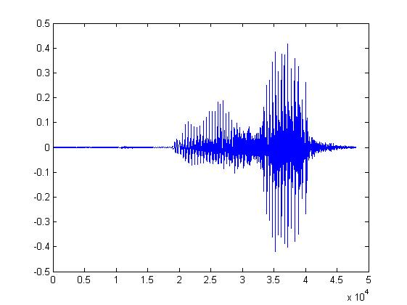
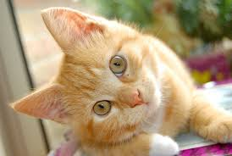
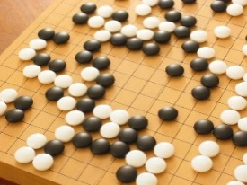
Machine Learning ≈ Looking for Function
Speech Recognition
Image Recognition
Playing Go
“How are you”
“Cat”
“5-5”
(next move)
Notes:
From Data

Slide 3

Different types of Functions
Regression: The function outputs a scalar.
Predict PM2.5
PM2.5 today
f
temperature
PM2.5 of tomorrow
Concentration
of O₃
Classification: Given options (classes), the function outputs the correct one.
Spam
filtering
f
Yes/No

Slide 4
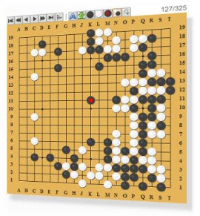

Different types of Functions
Classification: Given options (classes), the function outputs the correct one.
Each position is a class
(19 x 19 classes)
Function
a position on the board
Next move
Playing GO
Notes:
Reinforcement learning?

Slide 5
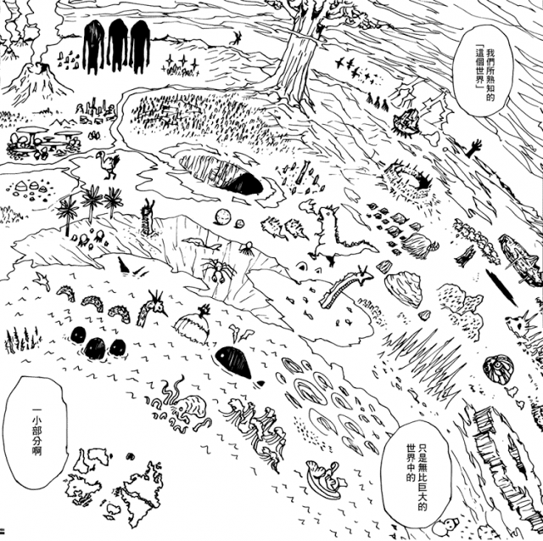
Structured Learning
create something with structure (image, document)
Regression, Classification

Slide 6

How to find a function? A Case Study
Notes:
Predicting the number of subscribers
(Skip this part is you already have basic idea about ML)
Gradient
Limitation
Deep Learning
Introduction

Slide 7

YouTube Channel
https://www.youtube.com/c/HungyiLeeNTU

Slide 8
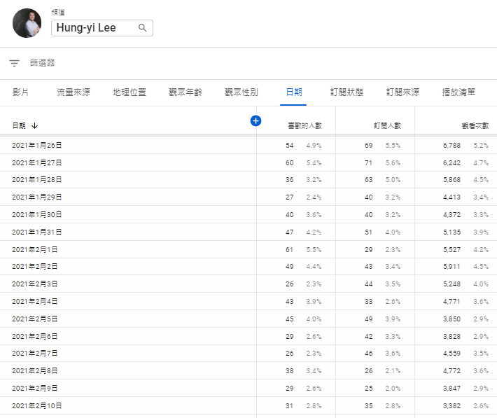
The function we want to find …
$$y=f\left( \right)$$
no. of views on 2/26

Slide 9
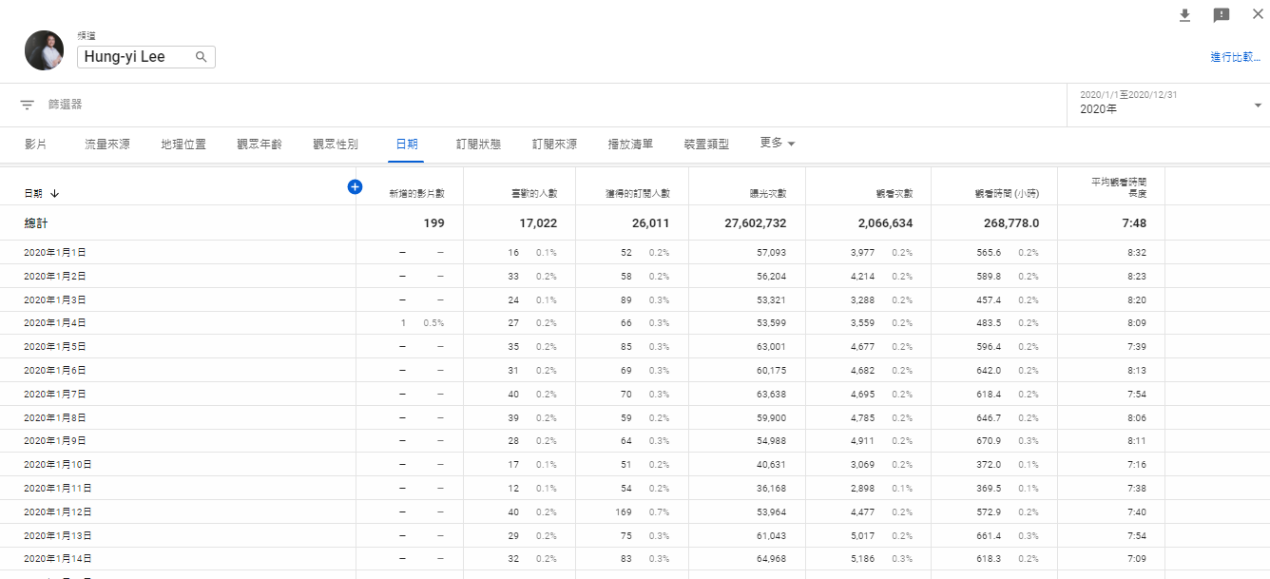

1. Function with Unknown Parameters
$$y=f\left( \right)$$
Model
$$y=b+wx_{1}$$
based on domain knowledge
feature
$y:$ no. of views on 2/26, $x_{1}:$ no. of views on 2/25
$w$ and $b$ are unknown parameters (learned from data)
weight
bias

Slide 10









2. Define Loss from Training Data
Loss is a function of parameters
$$L\left(b,w\right)$$
Loss: how good a set of values is.
$$L\left(0.5k,1\right)$$
$$y=b+wx_{1}$$
$$y=0.5k+1x_{1}$$
How good it is?
Data from 2017/01/01 – 2020/12/31
……
2017/01/01
01/02
01/03
2020/12/30
12/31
4.8k
4.9k
7.5k
3.4k
9.8k
$$\text{0.5}\text{k}\text{+1}x_{1}=y$$
5.3k
$$e_{1}$$
$$=\left|y−\hat{y}\right|$$
$$=0.4k$$
label
$$\hat{y}$$
4.9k
Notes:
Mean Square Error (MSE)

Slide 11








2. Define Loss from Training Data
Loss is a function of parameters
$$L\left(b,w\right)$$
Loss: how good a set of values is.
$$L\left(0.5k,1\right)$$
$$y=b+wx_{1}$$
$$y=0.5k+1x_{1}$$
How good it is?
Data from 2017/01/01 – 2020/12/31
……
2017/01/01
01/02
01/03
2020/12/30
12/31
4.8k
4.9k
7.5k
3.4k
9.8k
$$\text{0.5}\text{k}\text{+1}x_{1}=y$$
5.4k
$$\text{0.5}\text{k}\text{+1}x_{1}=y$$
$$e_{2}$$
$$=\left|y−\hat{y}\right|$$
$$=2.1k$$
$$e_{N}$$
$$\hat{y}$$
$$\hat{y}$$
4.9k
7.5k
9.8k
Notes:
Mean Square Error (MSE)

Slide 12


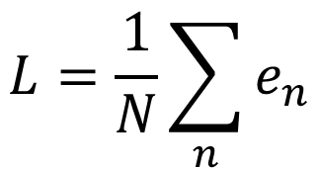
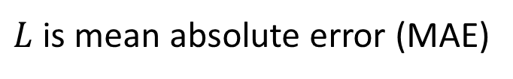

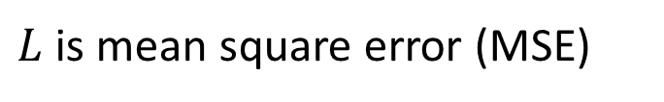



2. Define Loss from Training Data
Loss is a function of parameters
$$L\left(b,w\right)$$
Loss: how good a set of values is.
4.8k
4.9k
$$b+wx_{1}=y$$
$$L=\frac{1}{N}\sum_{n}{e_{n}}$$
Loss:
$$e_{1}$$
$$\hat{y}$$
4.9k
$$e=\left|y−\hat{y}\right|$$
$L$ is mean absolute error (MAE)
$$e={\left(y−\hat{y}\right)}^{2}$$
$L$ is mean square error (MSE)
If $y$ and $\hat{y}$ are both probability distributions
Cross-entropy

Slide 13
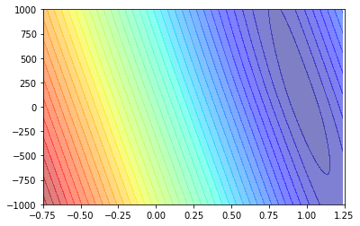


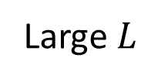


2. Define Loss from Training Data
Loss is a function of parameters
$$L\left(b,w\right)$$
Loss: how good a set of values is.
Model
$$y=b+wx_{1}$$
Small $L$
$$b$$
Error Surface
Large $L$
$$w$$
Notes:
MAE

Slide 14




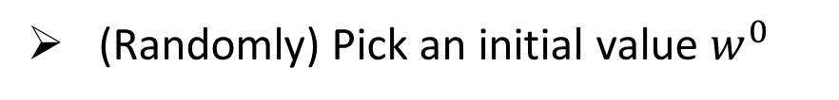
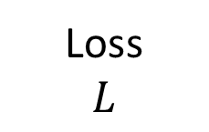

3. Optimization
Source of image: http://chico386.pixnet.net/album/photo/171572850
$$w^{∗},b^{∗}=arg\min_{w,b}{L}$$
Gradient Descent
(Randomly) Pick an initial value $w^{0}$
$$\frac{∂L}{∂w}|_{w=w^{0}}$$
Compute
Loss
$$L$$
Negative
Increase w
Positive
Decrease w
$$w^{0}$$
$$w$$
Notes:
In this case, this optimization problem can be solved directly.

Slide 15
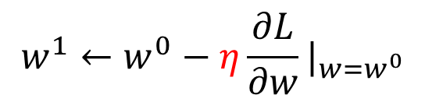



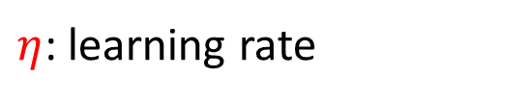
3. Optimization
Source of image: http://chico386.pixnet.net/album/photo/171572850
$$w^{∗},b^{∗}=arg\min_{w,b}{L}$$
Gradient Descent
(Randomly) Pick an initial value $w^{0}$
$$\frac{∂L}{∂w}|_{w=w^{0}}$$
Compute
Loss
$$L$$
$$w^{1}←w^{0}−η\frac{∂L}{∂w}|_{w=w^{0}}$$
$$η\frac{∂L}{∂w}|_{w=w^{0}}$$
$η$: learning rate
hyperparameters
$$w^{0}$$
$$w^{1}$$
$$w$$
Notes:
Eta
In this case, this optimization problem can be solved directly.

Slide 16



3. Optimization
Source of image: http://chico386.pixnet.net/album/photo/171572850
$$w^{∗},b^{∗}=arg\min_{w,b}{L}$$
Gradient Descent
(Randomly) Pick an initial value $w^{0}$
$$\frac{∂L}{∂w}|_{w=w^{0}}$$
Compute
Loss
$$L$$
$$w^{1}←w^{0}−η\frac{∂L}{∂w}|_{w=w^{0}}$$
Update $w$ iteratively
Does local minima truly cause the problem?
Local minima
global minima
$$w^{0}$$
$$w^{1}$$
$$w^{2}$$
$$w^{T}$$
$$w$$
Notes:
In this case, this optimization problem can be solved directly.

Slide 17

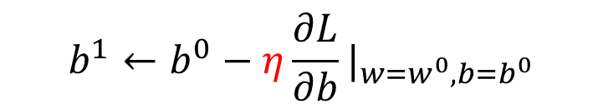


3. Optimization
$$w^{∗},b^{∗}=arg\min_{w,b}{L}$$
(Randomly) Pick initial values $w^{0}$, $b^{0}$
Compute
$$\frac{∂L}{∂w}|_{w=w^{0},b=b^{0}}$$
$$w^{1}←w^{0}−η\frac{∂L}{∂w}|_{w=w^{0},b=b^{0}}$$
$$\frac{∂L}{∂b}|_{w=w^{0},b=b^{0}}$$
$$b^{1}←b^{0}−η\frac{∂L}{∂b}|_{w=w^{0},b=b^{0}}$$
Can be done in one line in most deep learning frameworks
Update $w$ and $b$ interatively

Slide 18

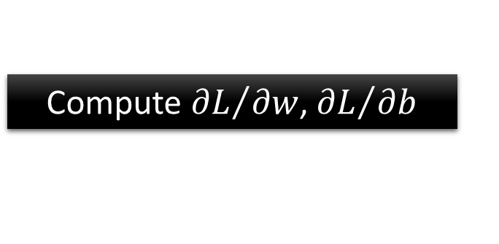
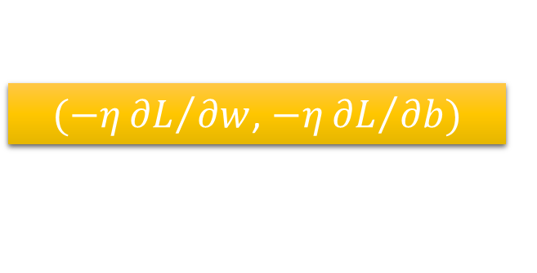





3. Optimization
Model
$$y=b+wx_{1}$$
$$w^{∗},b^{∗}=arg\min_{w,b}{L}$$
Compute ${∂L}/{∂w}$, ${∂L}/{∂b}$
$$w^{∗}=0.97,b^{∗}=0.1k$$
$$b$$
$$L\left(w^{∗},b^{∗}\right)=0.48k$$
$(−η{∂L}/{∂w}$, $−η{∂L}/{∂b})$
Compute ${∂L}/{∂w}$, ${∂L}/{∂b}$
$$w$$

Slide 19
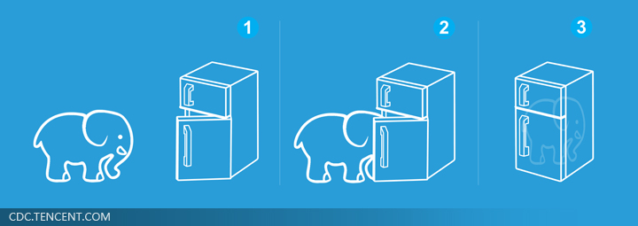



Machine Learning is so simple ……
Step 1: function with unknown
Step 2: define loss from training data
Step 3: optimization
$$w^{∗}=0.97,b^{∗}=0.1k$$
$$y=b+wx_{1}$$
$$L\left(w^{∗},b^{∗}\right)=0.48k$$

Slide 20

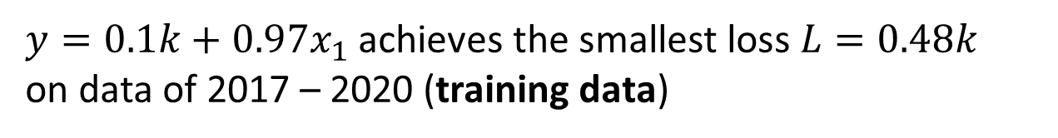
Machine Learning is so simple ……
Step 1: function with unknown
Step 2: define loss from training data
Step 3: optimization
$$w^{∗}=0.97,b^{∗}=0.1k$$
$$y=b+wx_{1}$$
$$L\left(w^{∗},b^{∗}\right)=0.48k$$
Training
$y=0.1k+0.97x_{1}$ achieves the smallest loss $L=0.48k$
on data of 2017 – 2020 (training data)
How about data of 2021 (unseen during training)?
$L′=0.58k$

Slide 21
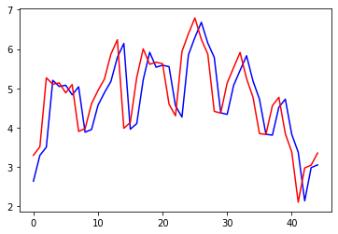

Red: real no. of views
blue: estimated no. of views
$$y=0.1k+0.97x_{1}$$
Views
(k)
2021/01/01
2021/02/14

Slide 22




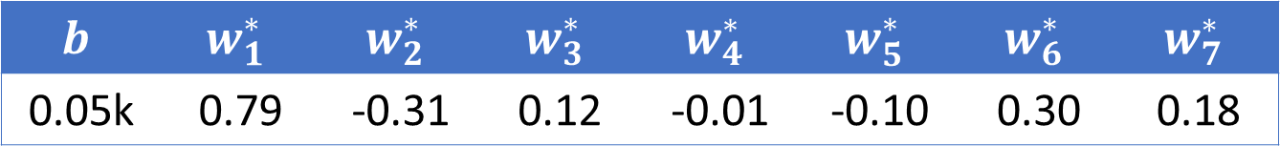
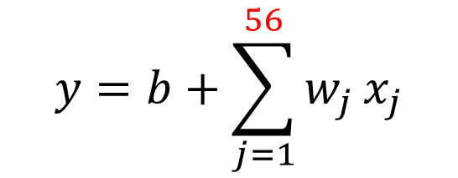




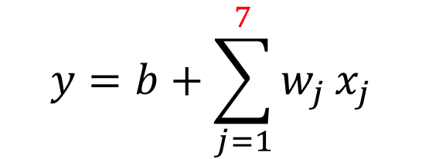


2017 - 2020
2021
$$y=b+wx_{1}$$
$L=0.48k$
$L′=0.58k$
$$y=b+\sum_{j=1}^{7}{w_{j}}x_{j}$$
2017 - 2020
2021
$L=0.38k$
$L′=0.49k$
$$b$$ | $$w_{1}^{∗}$$ | $$w_{2}^{∗}$$ | $$w_{3}^{∗}$$ | $$w_{4}^{∗}$$ | $$w_{5}^{∗}$$ | $$w_{6}^{∗}$$ | $$w_{7}^{∗}$$
0.05k | 0.79 | -0.31 | 0.12 | -0.01 | -0.10 | 0.30 | 0.18
$$y=b+\sum_{j=1}^{28}{w_{j}}x_{j}$$
2017 - 2020
2021
$L=0.33k$
$L′=0.46k$
$$y=b+\sum_{j=1}^{56}{w_{j}}x_{j}$$
2017 - 2020
2021
$L=0.32k$
$L′=0.46k$
Linear models

Slide 23
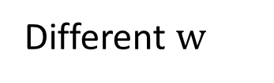

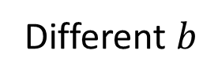


Linear models are too simple … we need more sophisticated modes.
$$y$$
Different $w$
Different $b$
$$x_{1}$$
$$x_{1}$$
Model Bias
Linear models have severe limitation.
We need a more flexible model!
Notes:
How to fit this one?
The summation of the blue functions is the green one.

Slide 24
red curve =
constant +
sum of a set of
$$y$$
1
3
0
$$x_{1}$$
$$x_{1}$$
2
Notes:
How to fit this one?
The summation of the blue functions is the green one.
Is it a

Slide 25
All Piecewise Linear Curves
constant +
sum of a set of
=
More pieces require more

Slide 26


Beyond Piecewise Linear?
Approximate continuous curve by a piecewise linear curve.
$$y$$
$$x_{1}$$
To have good approximation, we need sufficient pieces.
Notes:
How to fit this one?

Slide 27



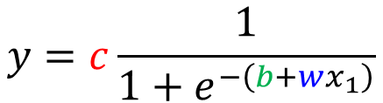
red curve =
constant +
sum of a set of
How to represent this function?
Hard Sigmoid
$$x_{1}$$
Sigmoid Function
$$y=c\frac{1}{1+e^{−\left(b+wx_{1}\right)}}$$
$$=c sigmoid\left(b+wx_{1}\right)$$
$$x_{1}$$
Notes:
Hard

Slide 28
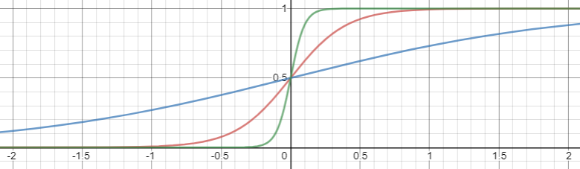
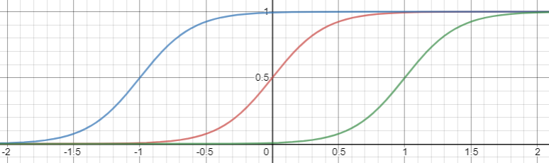
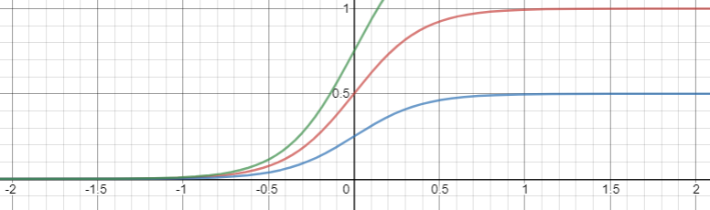
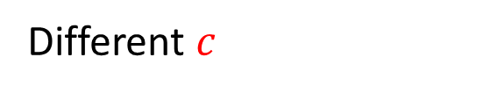
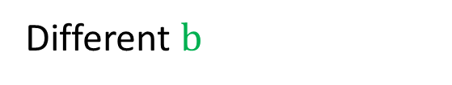
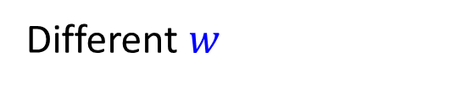
Different $w$
Change slopes
Different $b$
Shift
Different $c$
Change height

Slide 29



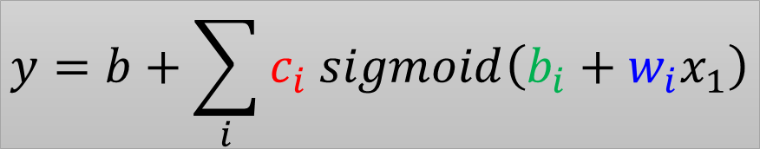
red curve =
sum of a set of
+ constant
$$y$$
$$c_{1} sigmoid\left(b_{1}+w_{1}x_{1}\right)$$
1
$$c_{3} sigmoid\left(b_{3}+w_{3}x_{1}\right)$$
3
0
$$x_{1}$$
$$y=b+\sum_{i}{c_{i} sigmoid\left(b_{i}+w_{i}x_{1}\right)}$$
$$x_{1}$$
0
1
+
2
+
3
$$c_{2} sigmoid\left(b_{2}+w_{2}x_{1}\right)$$
2
Notes:
How to fit this one?
The summation of the blue functions is the green one.

Slide 30
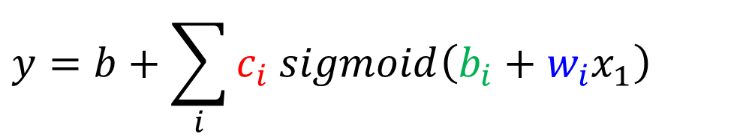
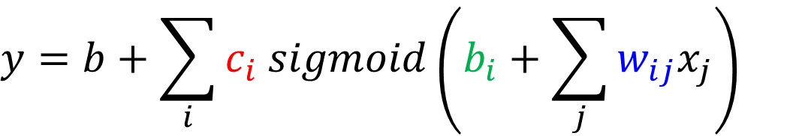
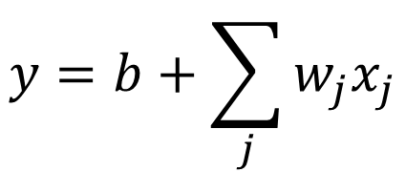

New Model: More Features
$$y=b+wx_{1}$$
$$y=b+\sum_{i}{c_{i} sigmoid\left(b_{i}+w_{i}x_{1}\right)}$$
$$y=b+\sum_{j}{w_{j}x_{j}}$$
$$y=b+\sum_{i}{c_{i} sigmoid\left(b_{i}+\sum_{j}{w_{ij}x_{j}}\right)}$$

Slide 31


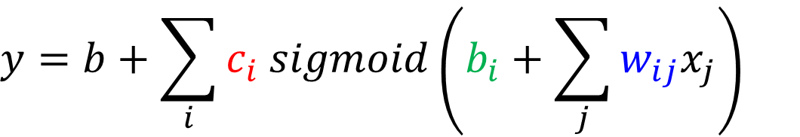














$$y=b+\sum_{i}{c_{i} sigmoid\left(b_{i}+\sum_{j}{w_{ij}x_{j}}\right)}$$
$$j:1,2,3$$
no. of features
$$i:1,2,3$$
no. of sigmoid
1
$$r_{1}=$$
$$b_{1}+w_{11}x_{1}+w_{12}x_{2}+w_{13}x_{3}$$
+
$$w_{11}$$
$$b_{1}$$
$$w_{12}$$
$$x_{1}$$
$w_{ij}$: weight for $x_{j}$ for i-th sigmoid
1
$$w_{13}$$
2
$$x_{2}$$
$$r_{2}=$$
$$b_{2}+w_{21}x_{1}+w_{22}x_{2}+w_{23}x_{3}$$
+
1
$$x_{3}$$
3
$$r_{3}=$$
$$b_{3}+w_{31}x_{1}+w_{32}x_{2}+w_{33}x_{3}$$
+
1

Slide 32




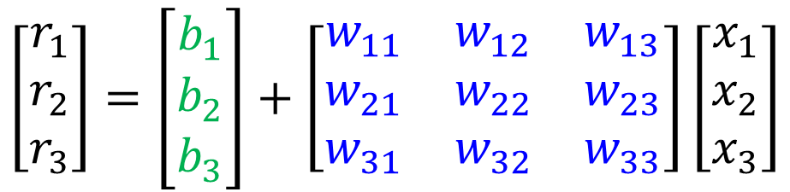




$$y=b+\sum_{i}{c_{i} sigmoid\left(b_{i}+\sum_{j}{w_{ij}x_{j}}\right)}$$
$$i:1,2,3$$
$$j:1,2,3$$
$$r_{1}=b_{1}+w_{11}x_{1}+w_{12}x_{2}+w_{13}x_{3}$$
$$r_{2}=b_{2}+w_{21}x_{1}+w_{22}x_{2}+w_{23}x_{3}$$
$$r_{3}=b_{3}+w_{31}x_{1}+w_{32}x_{2}+w_{33}x_{3}$$
$$\left[\begin{aligned}r_{1} \\ r_{2} \\ r_{3}\end{aligned}\right]=\left[\begin{aligned}b_{1} \\ b_{2} \\ b_{3}\end{aligned}\right]+\left[\begin{matrix}w_{11} & w_{12} & w_{13} \\ w_{21} & w_{22} & w_{23} \\ w_{31} & w_{32} & w_{33}\end{matrix}\right]\left[\begin{aligned}x_{1} \\ x_{2} \\ x_{3}\end{aligned}\right]$$
$$r$$
$$=$$
$$b$$
$$+$$
$$W$$
$$x$$

Slide 33





$$y=b+\sum_{i}{c_{i} sigmoid\left(b_{i}+\sum_{j}{w_{ij}x_{j}}\right)}$$
$$i:1,2,3$$
$$j:1,2,3$$
1
$$r_{1}$$
+
$$w_{11}$$
$$b_{1}$$
$$w_{12}$$
$$x_{1}$$
1
$$w_{13}$$
2
$$x_{2}$$
$$r$$
$$=$$
$$b$$
$$+$$
$$W$$
$$x$$
$$r_{2}$$
+
1
$$x_{3}$$
3
$$r_{3}$$
+
1
Notes:
10 9.1967
50 7.2083
100 6.5856

Slide 34




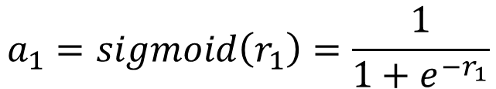


$$y=b+\sum_{i}{c_{i} sigmoid\left(b_{i}+\sum_{j}{w_{ij}x_{j}}\right)}$$
$$i:1,2,3$$
$$j:1,2,3$$
1
$$a_{1}$$
$$r_{1}$$
+
$$w_{11}$$
$$a_{1}=sigmoid\left(r_{1}\right)=\frac{1}{1+e^{−r_{1}}}$$
$$b_{1}$$
$$w_{12}$$
$$x_{1}$$
1
$$w_{13}$$
2
$$x_{2}$$
$$a_{2}$$
$$r_{2}$$
+
1
$$x_{3}$$
3
$$a$$
$$=σ\left( \right)$$
$$a_{3}$$
$$r_{3}$$
$$r$$
+
1

Slide 35










$$y=b+\sum_{i}{c_{i} sigmoid\left(b_{i}+\sum_{j}{w_{ij}x_{j}}\right)}$$
$$i:1,2,3$$
$$j:1,2,3$$
1
$$a_{1}$$
$$r_{1}$$
+
$$w_{11}$$
$$c_{1}$$
$$b_{1}$$
$$w_{12}$$
$$x_{1}$$
1
$$w_{13}$$
$$c_{2}$$
2
$$x_{2}$$
$$y$$
+
$$a_{2}$$
$$r_{2}$$
+
$$b$$
1
$$x_{3}$$
1
$$c_{3}$$
3
$$a_{3}$$
$$r_{3}$$
+
$$y$$
$$=$$
$$b$$
+
$$c^{T}$$
$$a$$
1

Slide 36





















1
$$a_{1}$$
$$r_{1}$$
+
$$w_{11}$$
$$c_{1}$$
$$b_{1}$$
$$w_{12}$$
$$x_{1}$$
1
$$w_{13}$$
$$c_{2}$$
2
$$x_{2}$$
$$y$$
+
$$a_{2}$$
$$r_{2}$$
+
$$b$$
1
$$x_{3}$$
1
$$c_{3}$$
3
$$a_{3}$$
$$r_{3}$$
+
$$=$$
+
$$a$$
1
$$y$$
$$b$$
$$c^{T}$$
$$a$$
$$=σ\left( \right)$$
$$r$$
$$=$$
$$+$$
$$W$$
$$x$$
$$r$$
$$b$$

Slide 37





1
$$a_{1}$$
$$r_{1}$$
+
$$w_{11}$$
$$c_{1}$$
$$b_{1}$$
$$w_{12}$$
$$x_{1}$$
1
$$w_{13}$$
$$c_{2}$$
2
$$x_{2}$$
$$y$$
+
$$a_{2}$$
$$r_{2}$$
+
$$b$$
1
$$x_{3}$$
1
$$c_{3}$$
3
$$a_{3}$$
$$r_{3}$$
+
1
$$y$$
$$=$$
+
+
$$W$$
$$x$$
$$σ\left( \right)$$
$$b$$
$$c^{T}$$
$$b$$

Slide 38




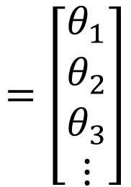

Function with unknown parameters
$$y$$
$$=$$
+
+
$$W$$
$$x$$
$$σ\left( \right)$$
$$b$$
$$c^{T}$$
$$b$$
$$x$$
feature
Rows of $W$
……
$$=\left[\begin{aligned}θ_{1} \\ θ_{2} \\ θ_{3} \\ ⋮\end{aligned}\right]$$
Unknown parameters
$$θ$$
$$W$$
$$b$$
$$c^{T}$$
$$b$$

Slide 39


Back to ML Framework
Step 1: function with unknown
Step 2: define loss from training data
Step 3: optimization
$$y$$
$$=$$
+
+
$$W$$
$$x$$
$$σ\left( \right)$$
$$b$$
$$c^{T}$$
$$b$$

Slide 40




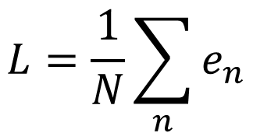
Loss
$$L\left(θ\right)$$
Loss is a function of parameters
Loss means how good a set of values is.
feature
$$y$$
$$=$$
+
+
$$W$$
$$x$$
$$σ\left( \right)$$
$$b$$
$$c^{T}$$
$$b$$
$$e$$
label
$$\hat{y}$$
Given a set of values
$$L=\frac{1}{N}\sum_{n}{e_{n}}$$
Loss:

Slide 41
Back to ML Framework
Step 1: function with unknown
Step 2: define loss from training data
Step 3: optimization
$$y$$
$$=$$
+
+
$$W$$
$$x$$
$$σ\left( \right)$$
$$b$$
$$c^{T}$$
$$b$$

Slide 42



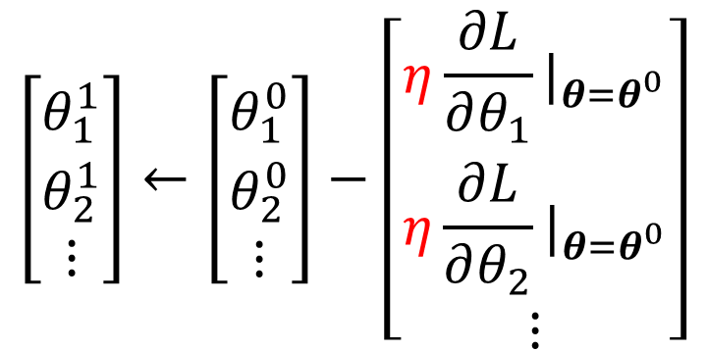
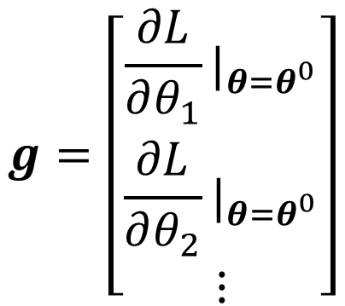


Optimization of New Model
$$=\left[\begin{aligned}θ_{1} \\ θ_{2} \\ θ_{3} \\ ⋮\end{aligned}\right]$$
$$θ$$
$$θ^{∗}=arg\min_{θ}{L}$$
(Randomly) Pick initial values $θ^{0}$
$$g=\left[\begin{aligned}\frac{∂L}{∂θ_{1}}|_{θ=θ^{0}} \\ \frac{∂L}{∂θ_{2}}|_{θ=θ^{0}} \\ ⋮\end{aligned}\right]$$
$$\left[\begin{aligned}θ_{1}^{1} \\ θ_{2}^{1} \\ ⋮\end{aligned}\right]←\left[\begin{aligned}θ_{1}^{0} \\ θ_{2}^{0} \\ ⋮\end{aligned}\right]−\left[\begin{aligned}η\frac{∂L}{∂θ_{1}}|_{θ=θ^{0}} \\ η\frac{∂L}{∂θ_{2}}|_{θ=θ^{0}} \\ ⋮\end{aligned}\right]$$
gradient
$$g=∇L\left(θ^{0}\right)$$
$$θ^{1}←θ^{0}−ηg$$

Slide 43






Optimization of New Model
$$θ^{∗}=arg\min_{θ}{L}$$
(Randomly) Pick initial values $θ^{0}$
Compute gradient $g=∇L\left(θ^{0}\right)$
$$θ^{1}←θ^{0}−ηg$$
Compute gradient $g=∇L\left(θ^{1}\right)$
$$θ^{2}←θ^{1}−ηg$$
Compute gradient $g=∇L\left(θ^{2}\right)$
$$θ^{3}←θ^{2}−ηg$$

Slide 44










Optimization of New Model
$$θ^{∗}=arg\min_{θ}{L}$$
B
batch
(Randomly) Pick initial values $θ^{0}$
$$L$$
Compute gradient $g=∇L^{1}\left(θ^{0}\right)$
$$L^{1}$$
batch
update
$$θ^{1}←θ^{0}−ηg$$
N
Compute gradient $g=∇L^{2}\left(θ^{1}\right)$
$$L^{2}$$
update
batch
$$θ^{2}←θ^{1}−ηg$$
Compute gradient $g=∇L^{3}\left(θ^{2}\right)$
$$L^{3}$$
$$θ^{3}←θ^{2}−ηg$$
batch
update
1 epoch = see all the batches once

Slide 45
Optimization of New Model
Example 1
B
batch
10,000 examples (N = 10,000)
Batch size is 10 (B = 10)
How many update in 1 epoch?
batch
1,000 updates
N
Example 2
1,000 examples (N = 1,000)
Batch size is 100 (B = 100)
batch
How many update in 1 epoch?
batch
10 updates

Slide 46
Back to ML Framework
Step 1: function with unknown
Step 2: define loss from training data
Step 3: optimization
$$y$$
$$=$$
+
+
$$W$$
$$x$$
$$σ\left( \right)$$
$$b$$
$$c^{T}$$
$$b$$
More variety of models …

Slide 47





Sigmoid $→$ ReLU
How to represent this function?
$$x_{1}$$
Rectified Linear Unit (ReLU)
$$c max\left(0,b+wx_{1}\right)$$
$$x_{1}$$
$$c′ max\left(0,b′+w′x_{1}\right)$$

Slide 48


Sigmoid $→$ ReLU
$$y=b+\sum_{i}{c_{i} sigmoid\left(b_{i}+\sum_{j}{w_{ij}x_{j}}\right)}$$
Activation function
$$y=b+\sum_{2i}{c_{i} max\left(0,b_{i}+\sum_{j}{w_{ij}x_{j}}\right)}$$
Which one is better?

Slide 49

Experimental Results
$$y=b+\sum_{2i}{c_{i} max\left(0,b_{i}+\sum_{j}{w_{ij}x_{j}}\right)}$$
 | linear | 10 ReLU | 100 ReLU | 1000 ReLU
2017 – 2020 | 0.32k | 0.32k | 0.28k | 0.27k
2021 | 0.46k | 0.45k | 0.43k | 0.43k

Slide 50
Back to ML Framework
Step 1: function with unknown
Step 2: define loss from training data
Step 3: optimization
$$y$$
$$=$$
+
+
$$W$$
$$x$$
$$σ\left( \right)$$
$$b$$
$$c^{T}$$
$$b$$
Even more variety of models …

Slide 51









+
$$a_{1}$$
+
$$x_{1}$$
1
1
$$x_{2}$$
+
$$a_{2}$$
+
1
or
1
$$x_{3}$$
……
+
$$a_{3}$$
+
1
1
$$a′$$
+
$$a$$
$$a$$
+
$$x$$
$$σ\left( \right)$$
$$σ\left( \right)$$
$$W$$
$$W′$$
$$=$$
$$=$$
$$b′$$
$$b$$

Slide 52
Experimental Results
Loss for multiple hidden layers
100 ReLU for each layer
input features are the no. of views in the past 56 days
 | 1 layer | 2 layer | 3 layer | 4 layer
2017 – 2020 | 0.28k | 0.18k | 0.14k | 0.10k
2021 | 0.43k | 0.39k | 0.38k | 0.44k

Slide 53

Red: real no. of views
blue: estimated no. of views
3 layers
Views
(k)
?
2021/01/01
2021/02/14

Slide 54
Back to ML Framework
Step 1: function with unknown
Step 2: define loss from training data
Step 3: optimization
$$y$$
$$=$$
+
+
$$W$$
$$x$$
$$σ\left( \right)$$
$$b$$
$$c^{T}$$
$$b$$
It is not fancy enough.
Let’s give it a fancy name!
Notes:
缺了個好名字呀~

Slide 55



hidden layer
hidden layer
+
$$a_{1}$$
+
$$x_{1}$$
1
1
$$x_{2}$$
+
$$a_{2}$$
+
1
1
$$x_{3}$$
……
+
$$a_{3}$$
+
Neuron
1
1
Neural Network
This mimics human brains … (???)
Many layers means Deep
Deep Learning

Slide 56



Deep = Many hidden layers
22 layers
http://cs231n.stanford.edu/slides/winter1516_lecture8.pdf
19 layers
8 layers
6.7%
7.3%
16.4%
AlexNet (2012)
VGG (2014)
GoogleNet (2014)

Slide 57

Deep = Many hidden layers
152 layers
101 layers
Special
structure
Why we want “Deep” network, not “Fat” network?
3.57%
7.3%
6.7%
16.4%
AlexNet (2012)
VGG
(2014)
GoogleNet
(2014)
Residual Net
(2015)
Taipei
101
Notes:
169層

Slide 58
Why don’t we go deeper?
Loss for multiple hidden layers
100 ReLU for each layer
input features are the no. of views in the past 56 days
 | 1 layer | 2 layer | 3 layer | 4 layer
2017 – 2020 | 0.28k | 0.18k | 0.14k | 0.10k
2021 | 0.43k | 0.39k | 0.38k | 0.44k

Slide 59
Why don’t we go deeper?
Loss for multiple hidden layers
100 ReLU for each layer
input features are the no. of views in the past 56 days
 | 1 layer | 2 layer | 3 layer | 4 layer
2017 – 2020 | 0.28k | 0.18k | 0.14k | 0.10k
2021 | 0.43k | 0.39k | 0.38k | 0.44k
Better on training data, worse on unseen data
Overfitting

Slide 60
Let’s predict no. of views today!
If we want to select a model for predicting no. of views today, which one will you use?
 | 1 layer | 2 layer | 3 layer | 4 layer
2017 – 2020 | 0.28k | 0.18k | 0.14k | 0.10k
2021 | 0.43k | 0.39k | 0.38k | 0.44k
We will talk about model selection next time. ☺

Slide 61


To learn more ……
Backpropagation
Basic Introduction
Computing gradients in an efficient way
https://youtu.be/Dr-WRlEFefw
https://youtu.be/ibJpTrp5mcE

Slide 62
Backpropagation笔记：
https://sakura-gh.github.io/ML-notes/ML-notes-html/9_Backpropagation.html

